Slide 1
Project Title: Detecting Faults in Manufacturing Process of Semiconductor using ML Models. ECN_358 Name : Aman Sinha Enrollment Number : 19116007 Email : aman_s@ec.iitr.ac.in

Slide 2
Outline
Introduction
Theory
Methodology
Observations
Result & Conclusion
References

Slide 3
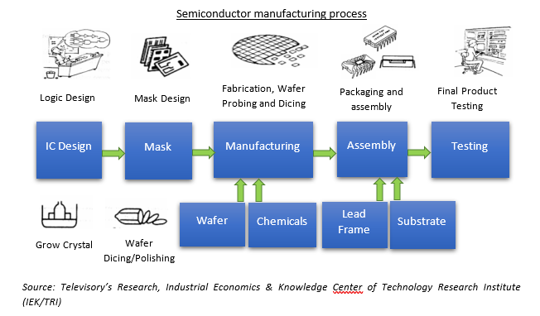
Introduction
Semiconductor devices are built on a series of nanofabrication processes performed on substrates made of a single purest silicon crystal. These substrates are commonly known as wafers.
Many sets of processes are involved in manufacturing process and major role of Machine Learning comes in the part of detecting faults in wafer designing and other processes during fabrication.

Slide 4
Theory
Semiconductor Manufacturing technique is getting advanced in more advanced VLSI technique with help Machine Learning Algorithms and predictive model. In manufacturing process, the raw parts like semiconductor materials, metals, insulators, dopants are converted into finished products.
Defects generally are found in the wafer region during fabrication process. Majorly caused by detecting flaw in crystal structure by heavily doping, mask getting misaligned with layers combination, improper oven temperatures, dust particle or impurity found during process, virus and bacteria found in wafer region.

Slide 5
Methodology
Firstly, importing the dataset in our Python code and removed unwanted features which are of no use. Some features are highly correlated like more than 90% and were removed. Replaced null values with standard techniques in ML in our dataset.
Then model is trained for the dataset which applies Logistic Regression, SVM, Decision Tree, and KNN.
Size of Dataset-[1567,590]
Number of Total Feature-592
And after feature selection process remaining features are 361.

Slide 6
Observations.
Model Training through Logistic Regression:
Accuracy of Training-0.9829787234042553
Accuracy of Testing-0.8852040816326531
Model Training through SVM:
Accuracy of Training-0.9421276595744681
Accuracy of Testing-0.9336734693877551
Model Training through Decision Tree:
Accuracy of Training-1.0 Accuracy of Testing-0.8724489795918368
Model Training through KNN:
Accuracy of Training-0.9361702127659575
Accuracy of Testing-0.9336734693877551

Slide 7
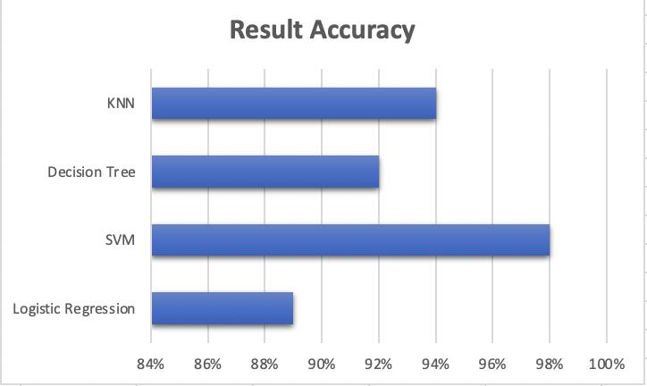
Result:
From the chart we can conclude SVM model is the best for the training getting the less difference in the accuracy of training and testing.

Slide 8
Conclusion
So lastly, I want to conclude that in this training model it accurately predict the equipment faults during the wafer fabrication process of the semiconductor industry.
As the training and testing both are very close to each set and at high rate.
We have tried for No underfitting and overfitting because model with high and low accuracy is training and testing were neglected.

Slide 9
References
[1] https://ieeexplore.ieee.org/abstract/document/6401531
[2]https://www.tandfonline.com/doi/abs/10.1080/00207540050205073
[3] https://thesai.org/Downloads/Volume11No12/Paper_25- Predictive_System_of_Semiconductor_Failures.pdf
[4] https://semiengineering.com/knowledge_centers/artificial- intelligence/machine-learning/

Slide 10
Thanks...

